Slide 1
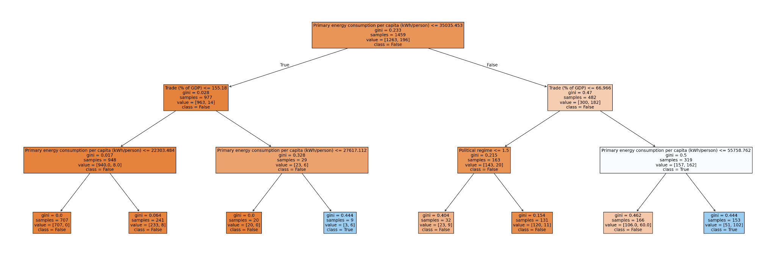
Success in Development: Keeping Gini low and GDP PPP high
Medha Das, Disha Hosapattana, Brenton Lian, Lydia Chen
SCHOOL OF DATA SCIENCE AND SOCIETY
Problem/Background
Decision Tree Analysis
Linear Regression Predictions
Across the world, economic growth has been associated with increasing rates of income inequalities. Some countries have been able to successfully increase their GDP per capita and reduce income inequalities. This project will explore how countries are able to keep their GDP per capita high while reducing income inequalities. This topic is very important because it can provide insights into how economic systems can be efficient. We hypothesize that a lower Gini coefficient and a higher GDP per capita is correlated with the political status of a country, the energy consumption of the country, and openness to trade.
Path 1 to high GDP PPP, and low Gini:
  Primary energy consumption per capita <= 35,035.453 kWh
  Trade more than 155.48% of GDP
  Primary energy consumption per capita <= 27,612.112 GDP PPP
Likely reflects states like Singapore or Hong Kong which are small and depend on trade for wealth
Path 2 to high GDP PPP, and low Gini:
  Primary energy consumption per capita >= 35,035.453 kWh
  Trade more than 67% of GDP
  Primary energy consumption per capita <= 55,758.62 kWh
Possibly reflects larger industrialized countries in temperate environments (less energy use) who depend more on non-trade revenues
Top 10 predicted countries for Combined GDP-Gini in 2043
Country | GDP-Gini Score
Vietnam | 1998884.27
Ireland | 270612.74
Denmark | 175715.10
Turkey | 157654.48
Malta | 153658.76
Luxembourg | 137639.86
Portugal | 130062.17
Germany | 117995.47
UK | 112054.51
US | 101750.14
Hypothesis
A free political system, high trade, and high energy consumption is associated with high GDP per capita and low Gini coefficient.
Data For Analysis
We utilized 5 datasets from Our World In Data:
Gini coefficient from 1963 - 2023
GDP per capita from 1990 - 2023
Political regime from 1789 - 2024
Trade as a share of GDP from 1960 - 2023
Energy use per person from 1965 - 2023.
We cleaned the datasets to only keep rows where all five indicators were all available. We choose these measures because these data points present diverse perspectives on what makes a country successful. Political regime represents politics, trade represents economic policy, while energy use can describe scientific achievement.
Our model had a score on train of 0.903, and a score on test of 0.877
Political regime note: Closed autocracies = 0, electoral autocracies = 1, electoral democracies = 2, and liberal democracies = 3.
Linear Regression Analysis
Conclusion
Top 7 Predicted Highest GDP-Gini Scores in 2022
Top 7 Actual Highest GDP-Gini Scores in 2022
Our decision tree model was relatively successful in identifying characteristics of countries with high GDP and low Gini, with a score on test of over 85%. Trade and moderate-high energy consumption were identified as important features, while political regime wasn’t.
Our linear regression model was successful in predicting countries with highest GDP-Gini scores, but, specific scores were not accurate.
For our 2022 actual data, the countries on the list mostly have relatively free political regimes and moderate to high energy use, but are not quite as high on trade as we expected. However, for our 2043 predictions, the vast majority of countries on the table are free politically, high in energy use, and have a high% of trade as part of their GDP.
Country | GDP-Gini score
Brazil | 1,630,000
USA | 48,200
Indonesia | 26,600
Mexico | 14,400
Chile | 6,640
Peru | 4,210
Colombia | 3,620
Country | GDP-Gini score
USA | 42733.35
Chile | 16835.08
Mexico | 12238.79
Peru | 9275.06
Brazil | 8903.12
Indonesia | 8599.02
Colombia | 8488.74
Models For Analysis
We decided to use a decision tree and linear regression for analysis. We used the decision tree to try to find which features are correlated with high GDP PPP and low Gini, while we used the linear regression model to try to predict future countries with high GDP PPP and low Gini.
We defined high GDP PPP as above $30,000 2021 US Dollars, while we defined low Gini as below 0.30. We used this metric in our decision tree analysis.
We also created a metric (GDP-Gini Score) that combines (1-Gini) * GDP PPP to create a new quantitative measure of if a country has has high GDP PPP and low Gini. We used this metric in our linear regression analysis.
References
https://ourworldindata.org/grapher/economic-inequality-gini-index
https://ourworldindata.org/grapher/gdp-per-capita-worldbank
https://ourworldindata.org/grapher/political-regime?time=latest
https://ourworldindata.org/grapher/trade-as-share-of-gdp
https://ourworldindata.org/energy
We successfully predicted all of the Top 7 highest GDP - Gini scores in 2022, although the ordering and specific numbers were different.
Notes:
‹#›
Add map, add med rec pic, flow diagram of med rec, little copy of the poster
Move risk factors into background section below)
Move objective and patients to middle colume. Combine patient population and methods
Number and add references to picture
Delete hospital patient records

Slide 2
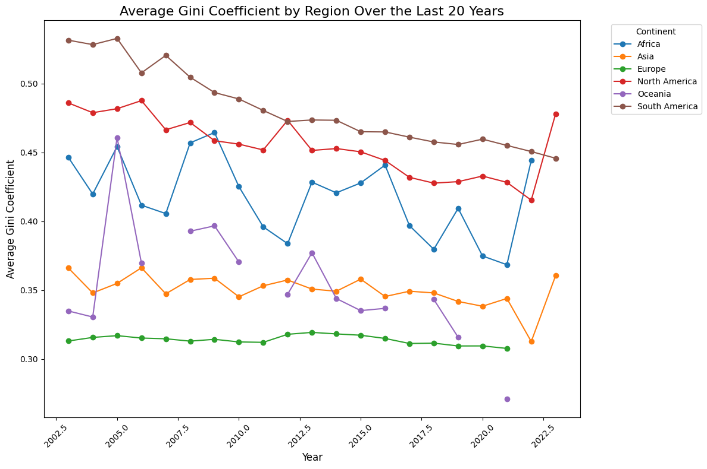
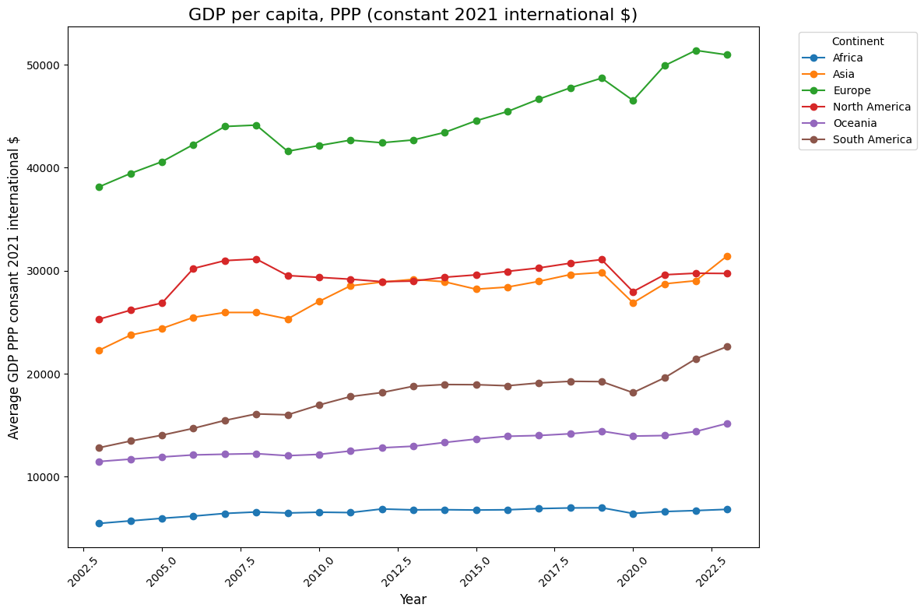
Decision Tree

Slide 3
